Slide 1
Promoting Positive Behavior

Slide 2
What do we know about successful intervention plans?
Hitting a peer
Teacher attention
Raising his hand
to signal the T.
When two responses serve the same function they are functionally equivalent

Slide 3
http://depts.washington.edu/stppbs/index.html

Slide 4
Positive Behavior Support Plan
Analyze the data --- determine the function.
Develop hypothesis statements.
Identify a situation in which you can consistently implement an intervention.
Based on that situation or problem behavior (hypothesis), menu a variety interventions
Choose one set of interventions
Make sure that you have buy in

Slide 5
Competing Behavior Diagrams
Desired Maintaining
Behavior Consequences
When presented with Heather yelled and T. ignored and H. a writing task dropped head to desk escaped writing
Setting Antecedent Problem Maintaining
Event Event Behavior Consequence
Replacement
Behavior

Slide 6
Competing Behavior Diagrams
Complete Task completed Assignment Escape
Desired Maintaining
Behavior Consequences
When presented with Heather yelled and T. ignored and H. a writing task dropped head to desk escaped writing
Setting Antecedent Problem Maintaining
Event Event Behavior Consequence
Replacement
Behavior

Slide 7
Competing Behavior Diagrams
Complete Task completed Assignment Escape
Desired Maintaining
Behavior Consequences
When presented with Heather yelled and T. ignored and H. a writing task dropped head to desk escaped writing
Setting Antecedent Problem Maintaining
Event Event Behavior Consequence
Ask for
Assistance
Replacement
Behavior

Slide 8
Make Problem Behavior Irrelevant, Ineffective, and Inefficient
Irrelevant
  Child no longer needs to use problem behaviors to achieve wants/needs
Ineffective
  Problem behavior no longer enables the child to achieve the function of his/her behavior
Inefficient
  Problem behaviors require much more effort and time to achieve purpose compared with acceptable behavior.

Slide 9
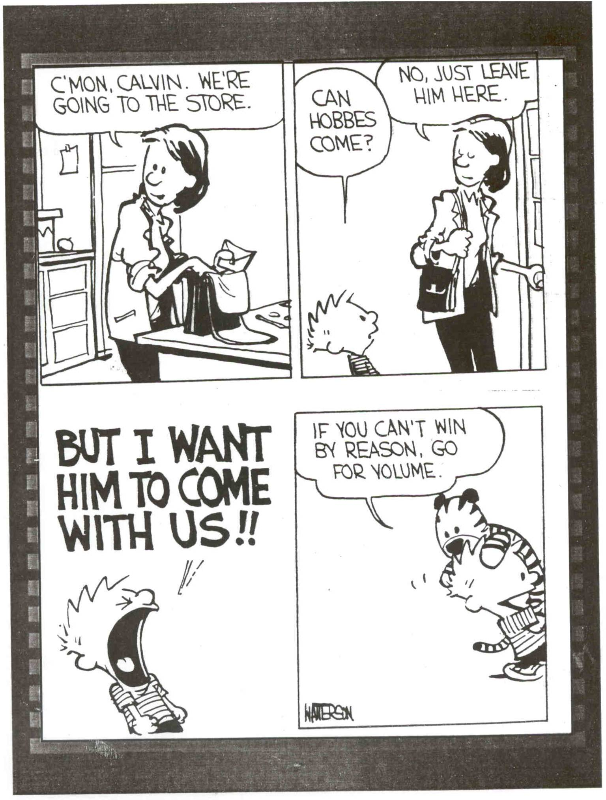
History of Reinforcement
Students come to us with a long history of being reinforced for particular behaviors

Slide 10
Antecedent Strategies
Address immediate antecedent events in the child’s environment that predict or trigger problem behavior.

Slide 11
Pre-specified Reinforcers
State the reinforcer to be delivered prior to the completion of a task or activity in which a problem behavior occurs.
Examples
“If you will sit at the booth during dinner, we will order some ice cream.”
“When you finish your math worksheet you can look at the magazines”

Slide 12
Pre-specified Reinforcers
Steps for Implementation
1. Assess preferences and reinforcers.
a. Make a list
b. Observe
c. Provide Choices
2. Deliver the request by stating the reinforcer to be delivered when the request is completed.
3. Child receives reinforcer AFTER engaging in and completing the activity.
Notes:
Identify a variety of reinforcers to offer the child so he/she does not get tired of a repeated reinforcer.
Make sure the child knows what he/she has to do to get the reinforcer.
An item may be preferred but the child may not be willing to complete a task in order to obtain the item.

Slide 13
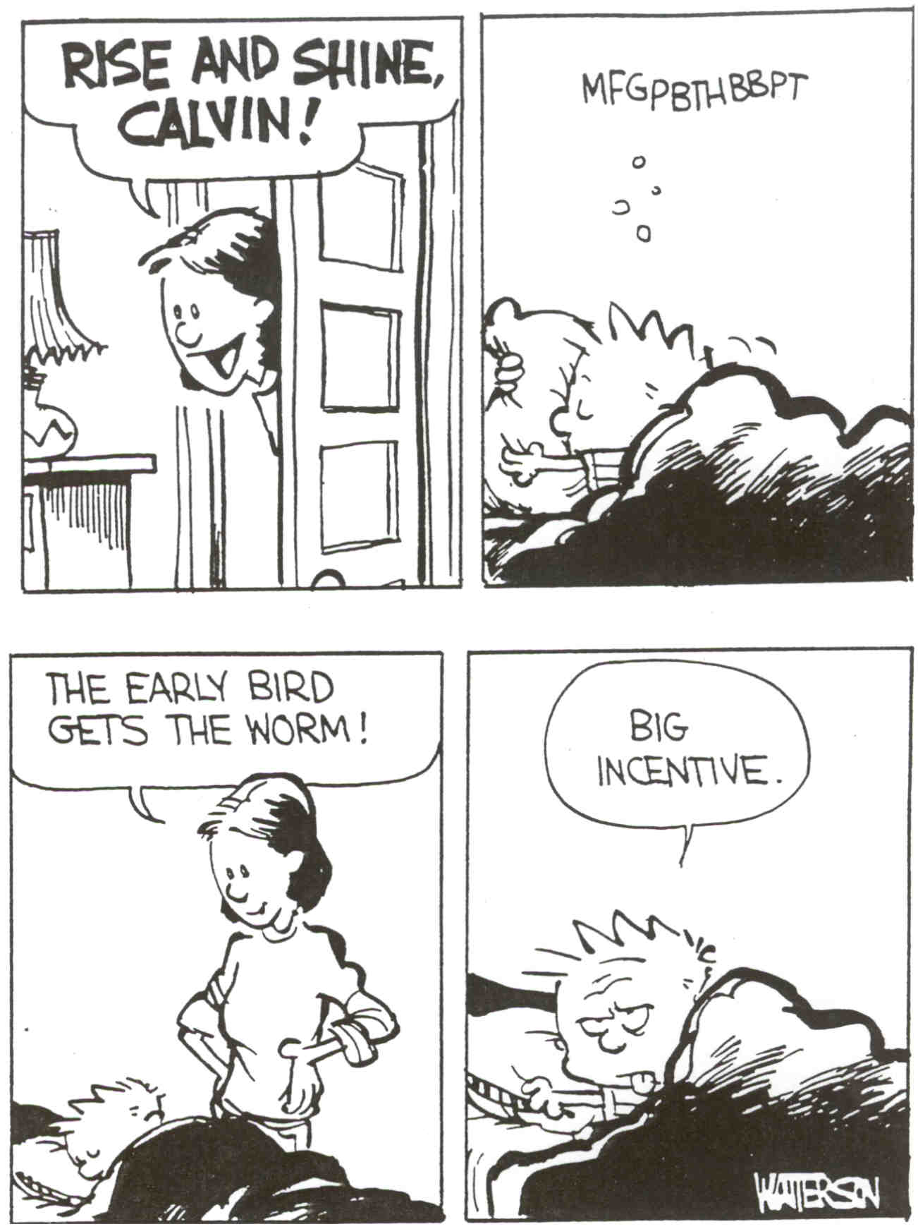

Slide 14
Preferred Activities or Objects as a Distractor
Engaging a child in an activity or object to distract him/her from the event in which the child usually engages in challenging behavior.
Examples
Giving children colors to work with while waiting for dinner.
Letting a child listen to a tape recorder while riding in the car/bus.

Slide 15
Preferred Activities or
Objects as a Distractor
Steps for Implementation
1. Identify objects that are preferred.
2. Identify objects that do not interfere with the target activity.
3. Engage child with the preferred object before beginning target activity or at point prior to which challenging behavior will occur.
Notes:
Increasing Effectiveness
Ensure the compatibility of the activity and the distractor.
Identify several preferred items.
Remember
Use new items and randomize them so they have more value because they are novel to the child.
Do not fade the distractor too quickly.

Slide 16
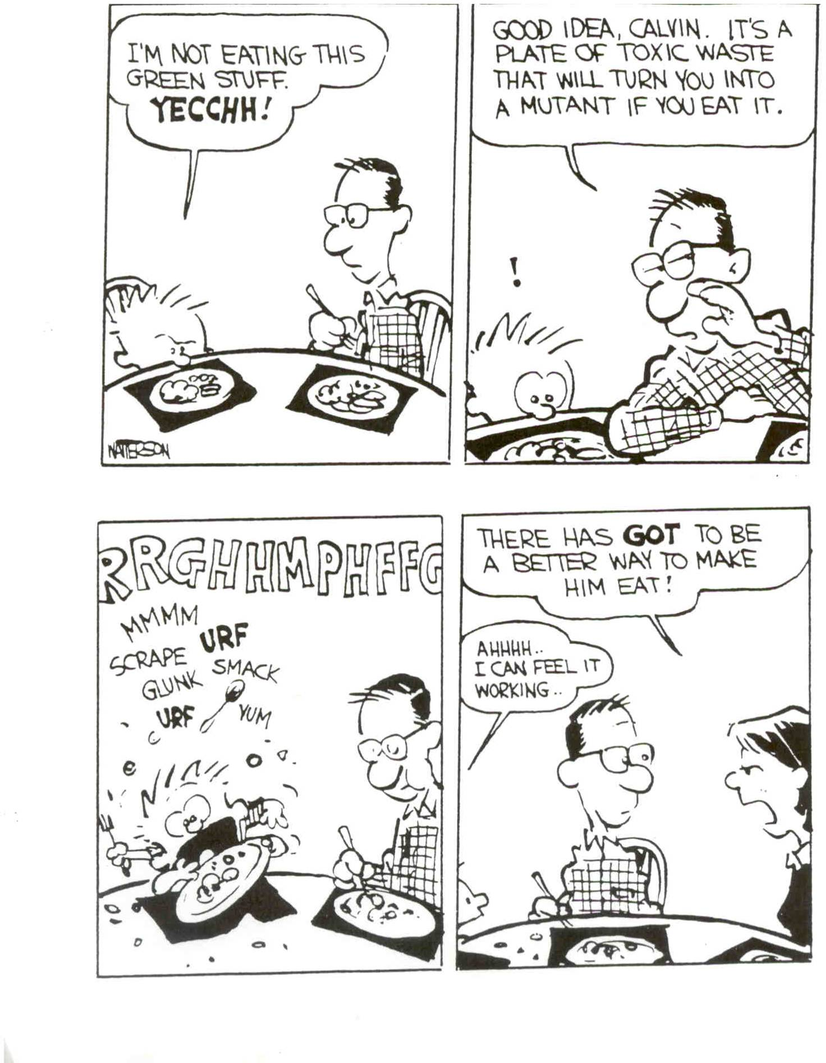

Slide 17
Choice Making
Examples
“Do you want to do the worksheet first or the reading first”
“Do you want to brush your teeth or wash you face?”
“Do you want to use the markers or the crayons?”
Offering choices of materials to be used, components of an activity, or undesired activities when presenting a request.

Slide 18
Choice Making
Steps for Implementation:
1. Identify activities in which choices can be offered
2. Identify an array of choices within activity.
3. Offer choices prior to the child engaging in challenging behavior.
Notes:
Increasing Effectiveness
Maintain control of items from which the child chooses.

Slide 19
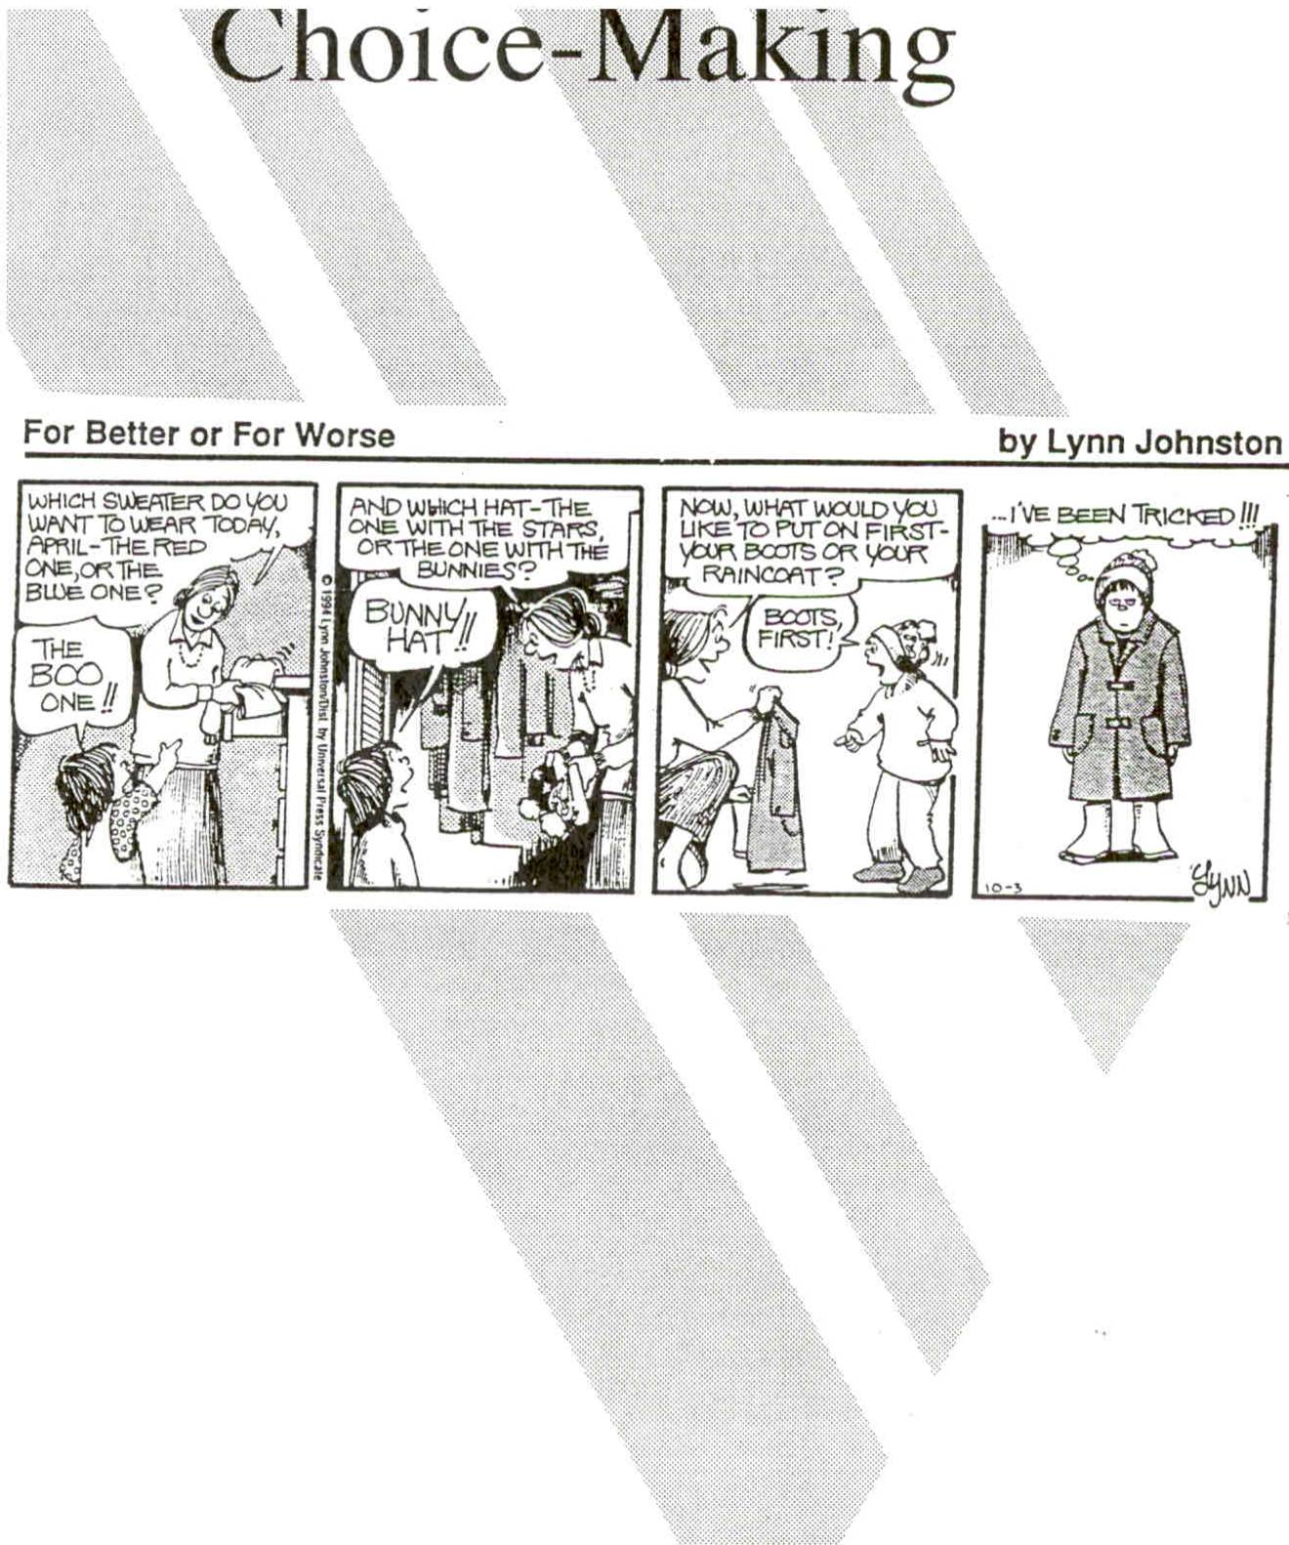

Slide 20
Collaborative Activities
Examples
“If you will put up three legos, I will put up three legos.”
“If you do the first three problems, I will do the next one.”
Sharing the responsibilities of the task or activity in which a child typically exhibits challenging behaviors.

Slide 21
Collaborative Activities
Steps for Implementation
1. Identify activity.
2. Split the responsibilities of the task.
3. Prior to the child’s engaging in challenging behavior, present the task demand in a collaborative fashion.
NOTE: This intervention is effective for those children that engage in challenging behavior to escape from an activity and obtain attention.
Notes:
Remember
Intermittently praise the child using words describing participation in the activity.
Be careful not to increase participation too quickly.

Slide 22
Tolerance for Delay of
Reinforcement
Examples
At the lunch table, the child begins to get fidgety. Mom says, “Two more bites.”
Dad sees someone and stops to talk, Margaret starts to complain that she wants to leave, Dad says, “One more minute.”
Teaching the child to (a) stay engaged in a task/activity, or (b) wait for a desired object for longer periods of time.

Slide 23
Tolerance for Delay of Reinforcement
Steps for Implementation
1. Identify the situation
2. Identify the shortest amount of time that the child will wait before exhibiting behavior. (CTP)
3. Choose a delay signal and a release signal.
4. Engage the child in the activity.

Slide 24
Tolerance for Delay of Reinforcement
Steps for Implementation (cont.)
5. Deliver the delay signal prior to the critical time period.
6. Continue engagement for a short time longer.
7. Deliver a release signal and reinforcement (e.g., release student from task, deliver requested object/tangible).
8. Gradually increase time child has to wait between signal and delivery of activity/object

Slide 25
High‑Probability Requests
A set of simple requests delivered just prior to a request in which the child typically does not comply.
Teacher
Child
Consequences
Alan, give me five.
Gives five
Teacher gives praise
Touch your ears.
Touches ear
Teacher gives praise
What is on your shirt?
Says “Batman”
Teacher gives praise
Sit in your chair.
Sits in chair.
Teacher gives praise

Slide 26
High‑Probability
Requests
Identify those requests that the child typically will complete. These tasks should be easy and quick to complete (High‑p requests)
Identify those requests in which the learner will not complete
Validate those requests.
Deliver three high-p requests immediately prior to delivering the low-p request.
Provide some type of feedback (i.e., praise, gesture, tangible)

Slide 27
Hypothesis Statement
Setting Events | Antecedent Strategies | Skill Development | Consequence Strategies

Slide 28
Teaching Strategies
Address the communication, social, and adaptive living skill deficits and needs of children with disabilities.
Strategies are linked to the skill deficits that are associated with the occurrence of problem behavior.

Slide 29
Strategies Teaching Replacement Behavior
General Rules for Implementing
Do not continue to reinforce the problem behavior
Minimize the probability that a problem behavior will occur prior to the acceptable communicative response
If possible, select a new response that is already part of the child’s existing repertoire.
Try to incorporate the natural maintaining contingencies offered by the natural environment

Slide 30
Teaching a Requesting Response
A socially acceptable request to:
withdraw from an uncompleted task with the expectation of returning (requesting a break)
gain someone’s attention (request attention)
gain someone’s assistance from someone (request assistance)
solicit praise or confirmation of completed work (request a work break)

Slide 31
Teaching a Requesting Response
Steps for implementation
Determine how long the child will stay with the task before engaging in the problem behavior
Just prior to arriving at this point, provide the child with the event to match the specific request you are trying to teach (escape, assistance, attention).
For example, if you are trying to teach the child to request a break, immediately prior to the point in which problem behavior usually exists, release the child from the task.

Slide 32
Teaching a Requesting Response
Steps for implementation (cont.)
Once the task has been associated with reinforcement (release from the task), prompt the child to request at the critical point before problem behavior occurs.
After a correct response, the child should be immediately provided the action to match the response
Over time, fade the prompts necessary for the child to make the desired request.
If the child begins to use the communicative response earlier, establish additional conditions.

Slide 33
Teaching a Rejecting Response
A socially acceptable response to avoid contact with an undesired activity, person, or object.
When given brussels sprouts at dinner, Karen says “Don’t like,” and they are removed.
Right before gym time, Ryan signs “all done” and does not have to go to gym.

Slide 34
Teaching a Rejecting Response
Steps for implementation
Identify the earliest possible at which the child attends to the approach of the undesired event without engaging in problem behavior
Reinforce the absence of problem behavior
Prompt or model the desired response in the presence of the undesired event
Shape successfully better approximations or gradually reduce the child’s reliance on prompts.
Insure that rejecting is used conditionally

